Slide 1
AIMD of bulk liquid water

Slide 2
Simulation Details
Software used – CP2K
Quickstep method is used to expand the wave function.
Exchange Correlation Functional used – PBE
Basis set used – DZVP-GTH-PADE
Psedopotential used – GTH-PBE
Cell dimension(angstrom)- 12.42, 12.42, 12.42
Water molecules taken- 64
Ensemble used- NVT
Temperature taken(K)- 300
Time step(fs)- 0.5

Slide 3
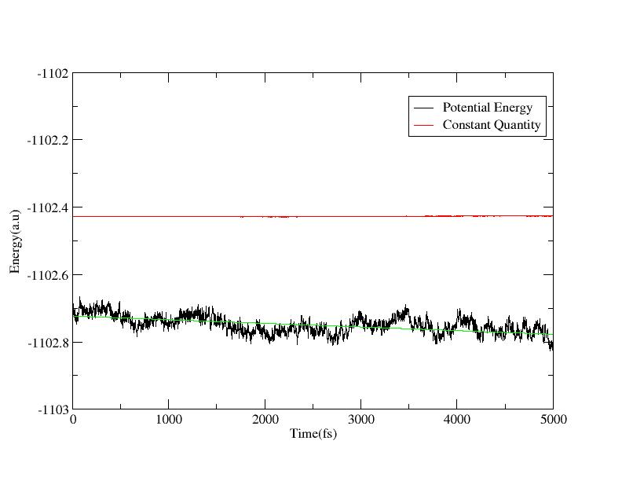
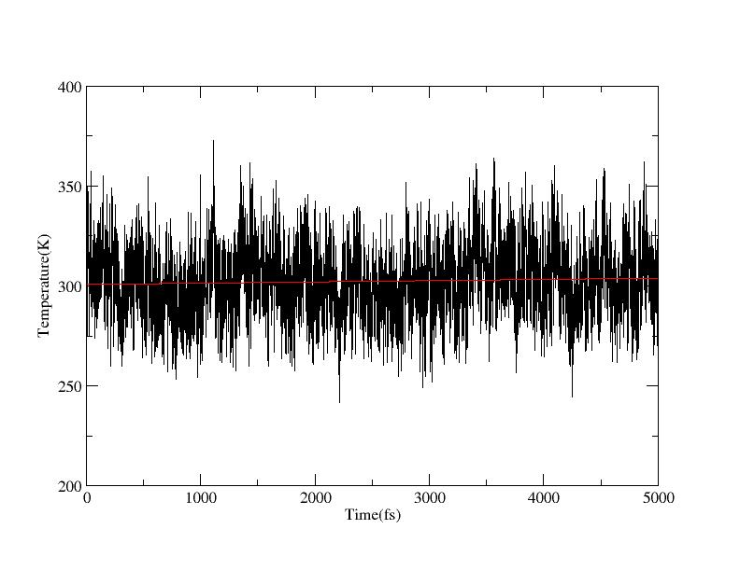
Analysis of .ener file
The temperature and potential energy of the system is oscillating around an average.

Slide 4
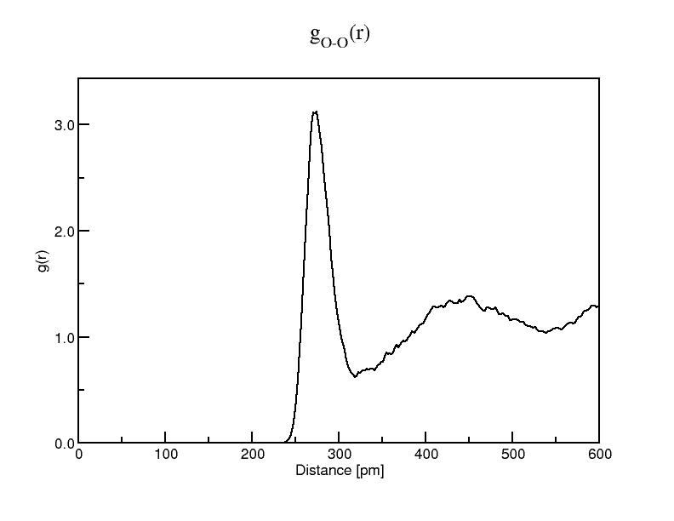
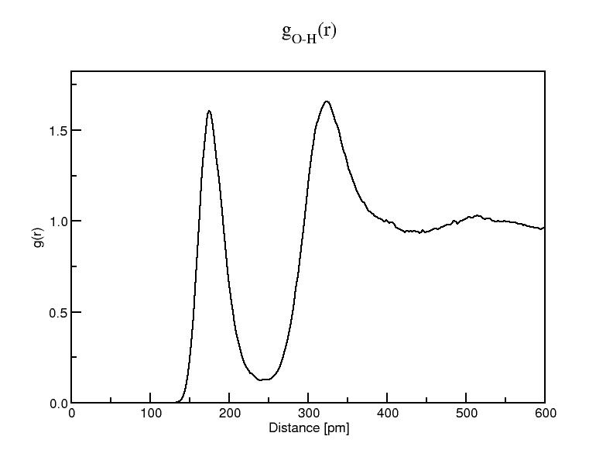
Analysis of Trajectory file: Computing intermolecular RDF for water molecules
O-O and O-H Pair distribution function

Slide 5
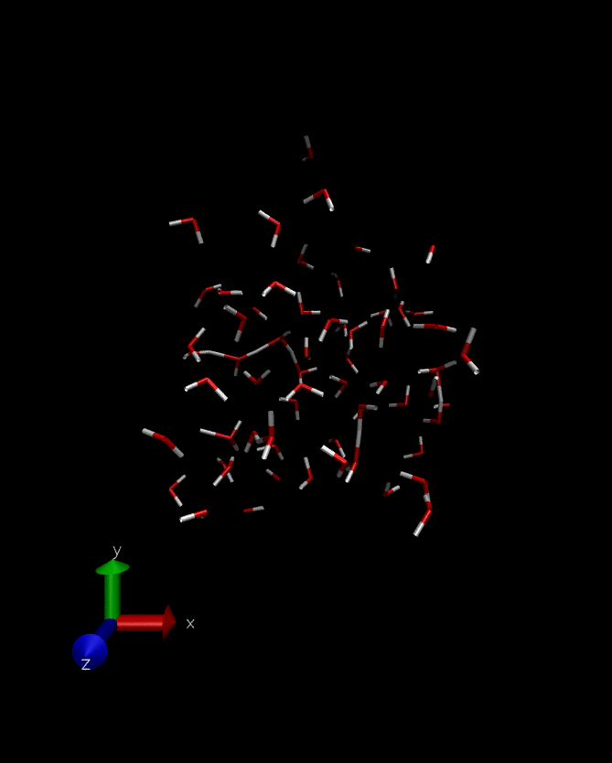
AIMD of simple ions in water: replaced one water molecule with H+
Note-view in slideshow mode
Gif showing quantum effects and the Grotthus Mechanism

Slide 6
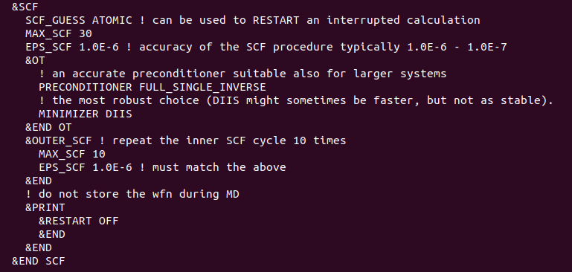
Up to 6 significant digits, value of energy can be correct as the Self Consistent Field(SCF) accuracy is E-06
Screenshot of the section of CP2K input file

Slide 7
Work in progress
Understanding various sections of the input file of CP2k.
Computing Bulk phase vibrational spectra based on AIMD by CP2K .

